Slide 1



MARCH
2025
The Smartest Way to Market on WhatsApp—Affordably!
A Vision of CSE Group-7

Slide 2

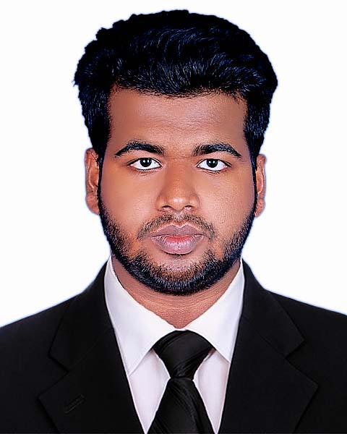





Meet Our Team
Setu Mondal
Team Member
2403051051376
Shreejal Dhakal
Team Member
2403051051370
Shubham Kumar
Team Member
2403051051374
Vitumbiko Ziba
Team Member
2403051051378
Shuvo Das
Team Leader
2403051051377
Monami Sadhu
Team Member
2403051051375

Slide 3


INTRODUCTION
Marketing costs are rising, making it harder for businesses to reach their audience. Our advanced WhatsApp marketing software provides an affordable, efficient, and scalable solution to help businesses grow without high advertising expenses.
PARUL UNIVERSITY
Innovated by CSE Group 7

Slide 4
NEXT VOICE

Slide 5


Problem Statement .
As businesses grow, marketing becomes essential, but it’s also one of the biggest expenses. Small business owners face a tough challenge—without marketing, they struggle to get sales, but with marketing, the costs eat into their profits. Many businesses don’t fail because of bad products; they simply can’t afford to reach the right customers. Traditional marketing is expensive, making it hard for small businesses to compete. Without an affordable solution, many get stuck or even shut down.
PARUL UNIVERSITY
Innovated by CSE Group 7

Slide 6




Solution: WhatsApp Marketing Software – Features & Benefits
Bulk Messaging
Lead Generation
Detailed Reports
Upload an Excel file with contacts, start the campaign & messages will be sent individually to each number—no limits!
Extract contacts from WhatsApp groups, Google Maps & social media.
Track message delivery, engagement & response rates.

Slide 7
NEXT VOICE

Slide 8

Why WhatsApp Marketing?
Smart, Affordable & Effective!
Huge User Base
Direct & Personal
Over 2 billion active users worldwide.
Messages go straight to customers’ phones.
High Engagement
Multi-Media Support
98% open rate, much higher than emails.
Send Text, Images, Videos, & Documents.
Automation & Bulk Messaging
Global Reach
Save time with auto-replies and mass messaging.
Connect with customers anywhere in the world.

Slide 9

Marketing Flow With WhatsApp
PARUL UNIVERSITY
Innovated by CSE Group 7

Slide 10
NEXT VOICE

Slide 11
Why Not Use Other Software or Systems?
Why pay more when you can marketing for free?
High Cost
Limited Reach
Other marketing tools & ads are expensive.
Email & SMS have lower open rates than WhatsApp.
No Direct Engagement
Restrictions & Bans
Social media ads don’t guarantee direct customer interaction.
Many tools face limitations or account bans.
Complex Setup
No Lead Extraction
Most tools don’t offer built-in lead generation from WhatsApp, Google Maps or social media.
Other systems require technical skills & setup time.

Slide 12


Why Use Our Software?
Save Time, Cut Costs & Boost Sales Effortlessly!
Unlimited Messaging
Easy Contact Upload
No restrictions on sending messages.
Import numbers via Excel files.
Automated Marketing
Targeted Lead Generation
Bulk messaging, auto-replies & scheduled campaigns.
Extract contacts from WhatsApp groups, Google Maps & social media.
Multi-Account Support
Detailed Reports
Manage multiple WhatsApp accounts easily.
Track message delivery & engagement.

Slide 13
NEXT VOICE

Slide 14
Upload Contacts
Import numbers from an Excel file.
How It Works
Create Message
Write text & add images, videos, or PDFs.
Fast, Easy & Unlimited!
Start Campaign
Messages are sent one by one automatically.
Track Performance
View delivery & response reports.

Slide 15



How We Generate Revenue
Software Sales
License Fees
Subscription Model
Sell the WhatsApp marketing software to businesses and individuals.
Charge for software licenses with customizable pricing & duration.
Offer monthly or yearly plans for premium features.

Slide 16
NEXT VOICE

Slide 17



Service-Based Business Model
Bulk Messaging Services
Customization Services
Lead Generation Services
Offer message-sending as a paid service.
Provide custom solutions based on client needs.
Charge businesses for targeted contact lists.

Slide 18
Conclusion
Our WhatsApp marketing software offers an affordable & effective way for businesses to grow without high advertising costs. It simplifies marketing with bulk messaging, lead generation & automation while helping businesses increase repeat customers. With direct communication and a strong revenue model, our solution is a game-changer for cost-effective business growth.
PARUL
UNIVERSITY
Innovated by CSE Group 7

Slide 19


THANK YOU .
PARUL UNIVERSITY
Innovated by CSE Group 7

Slide 20

Q & A Session
Clearing Doubts, One Question at a Time

